Slide 1
Election Prep Ages of Registered Voters
Elizabeth Mastilak

Slide 2
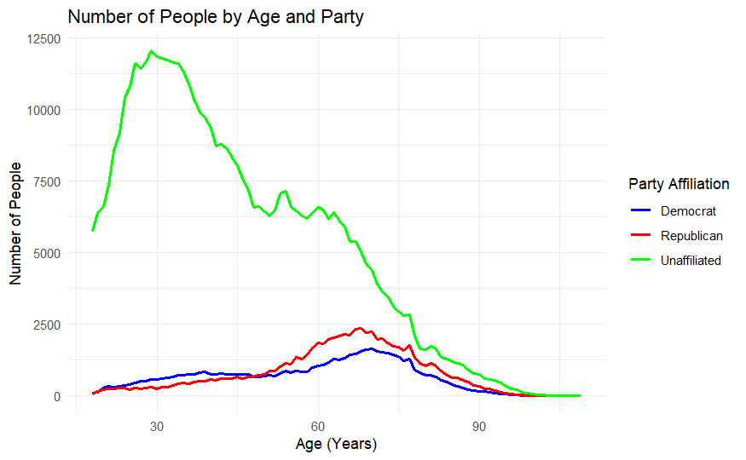
Average Ages:
Democrat: 58
Republican: 63
Unaffiliated: 45
Most registered voters in Hamilton County are not affiliated with a political party.

Slide 3
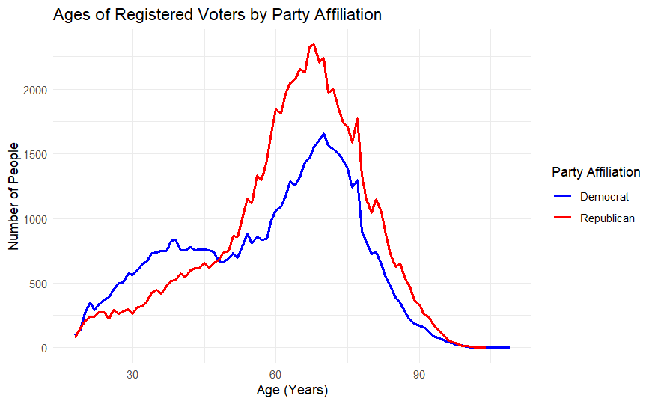
Average Ages:
Democrat: 58
Republican: 63
Younger voters are more likely to vote Democrat than Republican

